Slide 1

Branston Junior Academy
Calculation Policy

Slide 3
Addition

Slide 5

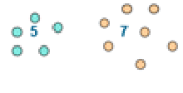
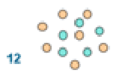

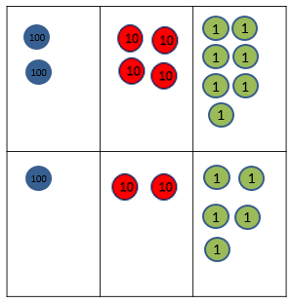


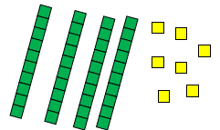
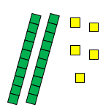
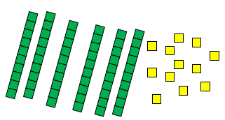
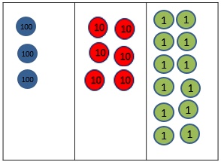
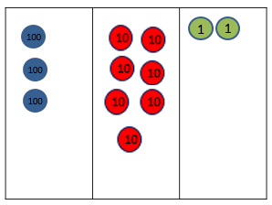
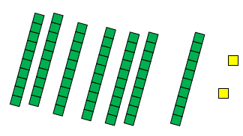


Year 1 | Year 2 | Year 3
+ = signs and missing numbers Children need to understand the concept of equality before using the ‘=’ sign. Calculations should be written either side of the equality sign so that the sign is not just interpreted as ‘the answer’. 2 = 1+ 1 2 + 3 = 4 + 1 Missing numbers need to be placed in all possible places. 3 + 4 = = 3 + 4 3 + = 7 7 = + 4 Counting and Combining sets of Objects Combining two sets of objects (aggregation) which will progress onto adding on to a set (augmentation) Understanding of counting on with a numbertrack. Understanding of counting on with a numberline (supported by models and images). 7+ 4 | Missing number problems e.g 14 + 5 = 10 + 32 + + = 100 35 = 1 + + 5 It is valuable to use a range of representations (also see Y1). Continue to use numberlines to develop understanding of: Counting on in tens and ones 23 + 12 = 23 + 10 + 2 = 33 + 2 = 35 Partitioning and bridging through 10. The steps in addition often bridge through a multiple of 10 e.g. Children should be able to partition the 7 to relate adding the 2 and then the 5. 8 + 7 = 15 Adding 9 or 11 by adding 10 and adjusting by 1 e.g. Add 9 by adding 10 and adjusting by 1 35 + 9 = 44 Towards a Written Method Partitioning in different ways and recombine 47+25 47 25 60 + 12 Leading to exchanging: 72 Expanded written method 40 + 7 + 20 + 5 = 40+20 + 7 + 5 = 60 + 12 = 72 | Missing number problems using a range of equations as in Year 1 and 2 but with appropriate, larger numbers. Partition into tens and ones Partition both numbers and recombine. Count on by partitioning the second number only e.g. 247 + 125 = 247 + 100 + 20+ 5 = 347 + 20 + 5 = 367 + 5 = 372 Children need to be secure adding multiples of 100 and 10 to any three-digit number including those that are not multiples of 10. Towards a Written Method Introduce expanded column addition modelled with place value counters (Dienes could be used for those who need a less abstract representation) Leading to children understanding the exchange between tens and ones. Some children may begin to use a formal columnar algorithm, initially introduced alongside the expanded method. The formal method should be seen as a more streamlined version of the expanded method, not a new method.

Slide 6
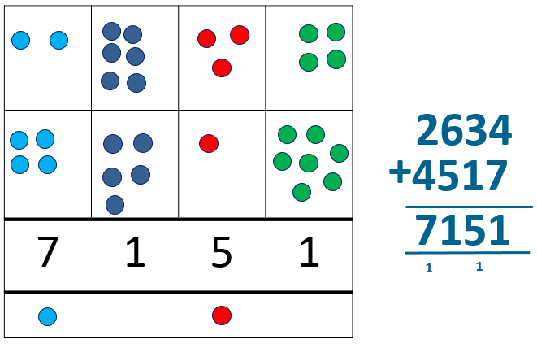
Year 4 | Year 5 | Year 6
Missing number/digit problems: Mental methods should continue to develop, supported by a range of models and images, including the number line. The bar model should continue to be used to help with problem solving. Written methods (progressing to 4-digits) Expanded column addition modelled with place value counters, progressing to calculations with 4-digit numbers. Compact written method Extend to numbers with at least four digits. Children should be able to make the choice of reverting to expanded methods if experiencing any difficulty. Extend to up to two places of decimals (same number of decimals places) and adding several numbers (with different numbers of digits). 72.8 + 54.6 127.4 1 1 | Missing number/digit problems: Mental methods should continue to develop, supported by a range of models and images, including the number line. The bar model should continue to be used to help with problem solving. Children should practise with increasingly large numbers to aid fluency e.g. 12462 + 2300 = 14762 Written methods (progressing to more than 4-digits) As year 4, progressing when understanding of the expanded method is secure, children will move on to the formal columnar method for whole numbers and decimal numbers as an efficient written algorithm. 172.83 + 54.68 227.51 1 1 1 Place value counters can be used alongside the columnar method to develop understanding of addition with decimal numbers. | Missing number/digit problems: Mental methods should continue to develop, supported by a range of models and images, including the number line. The bar model should continue to be used to help with problem solving. Written methods As year 5, progressing to larger numbers, aiming for both conceptual understanding and procedural fluency with columnar method to be secured. Continue calculating with decimals, including those with different numbers of decimal places Problem Solving Teachers should ensure that pupils have the opportunity to apply their knowledge in a variety of contexts and problems (exploring cross curricular links) to deepen their understanding. .

Slide 7
Subtraction

Slide 9
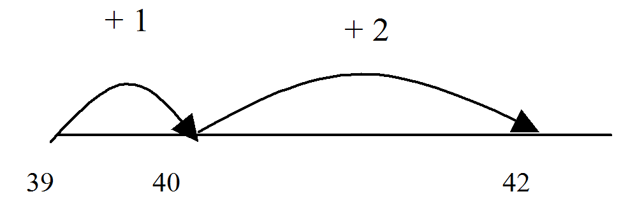
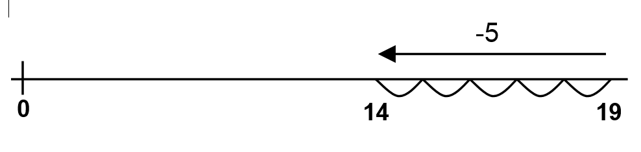
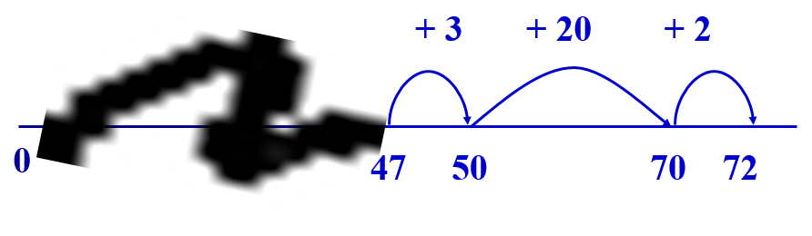
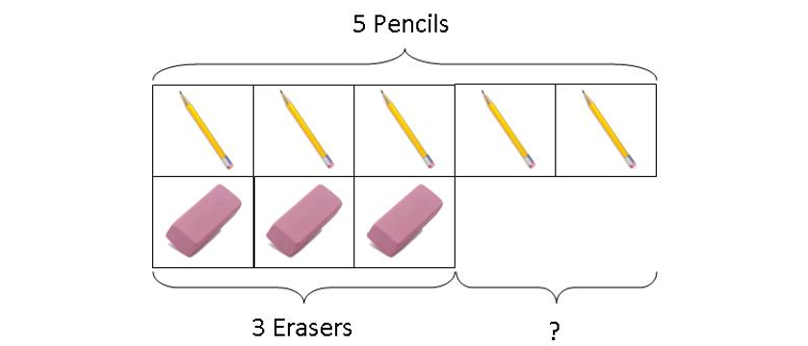
Year 1 | Year 2 | Year 3
Missing number problems e.g. 7 = □ - 9; 20 - □ = 9; 15 – 9 = □; □ - □ = 11; 16 – 0 = □ Use concrete objects and pictorial representations. If appropriate, progress from using number lines with every number shown to number lines with significant numbers shown. Understand subtraction as take-away: Understand subtraction as finding the difference: The above model would be introduced with concrete objects which children can move (including cards with pictures) before progressing to pictorial representation. The use of other images is also valuable for modelling subtraction e.g. Numicon, bundles of straws, Dienes apparatus, multi-link cubes, bead strings | Missing number problems e.g. 52 – 8 = □; □ – 20 = 25; 22 = □ – 21; 6 + □ + 3 = 11 It is valuable to use a range of representations (also see Y1). Continue to use number lines to model take-away and difference. E.g. The link between the two may be supported by an image like this, with 47 being taken away from 72, leaving the difference, which is 25. The bar model should continue to be used, as well as images in the context of measures. Towards written methods Recording addition and subtraction in expanded columns can support understanding of the quantity aspect of place value and prepare for efficient written methods with larger numbers. The numbers may be represented with Dienes apparatus. E.g. 75 – 42 | Missing number problems e.g. □ = 43 – 27; 145 – □ = 138; 274 – 30 = □; 245 – □ = 195; 532 – 200 = □; 364 – 153 = □ Mental methods should continue to develop, supported by a range of models and images, including the number line. The bar model should continue to be used to help with problem solving (see Y1 and Y2). Children should make choices about whether to use complementary addition or counting back, depending on the numbers involved. Written methods (progressing to 3-digits) Introduce expanded column subtraction with no decomposition, modelled with place value counters (Dienes could be used for those who need a less abstract representation) For some children this will lead to exchanging, modelled using place value counters (or Dienes). A number line and expanded column method may be compared next to each other. Some children may begin to use a formal columnar algorithm, initially introduced alongside the expanded method. The formal method should be seen as a more streamlined version of the expanded method, not a new method.

Slide 10
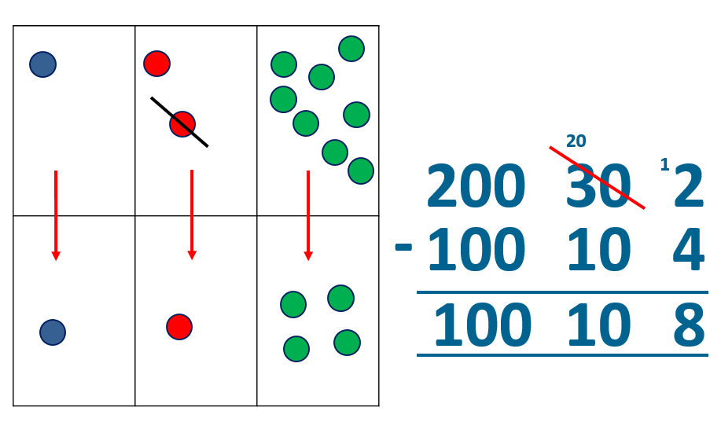
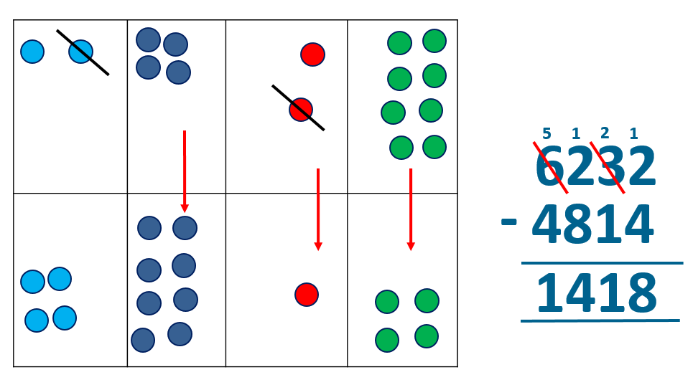
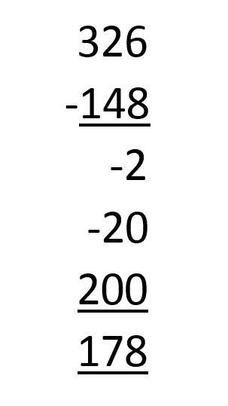
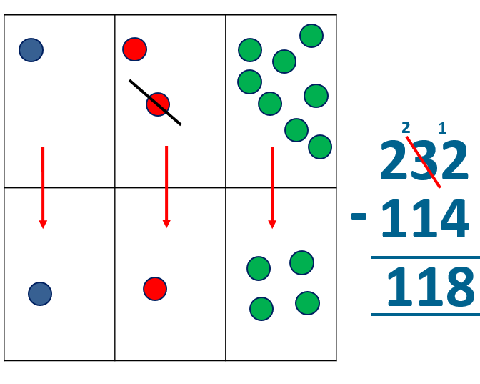
Year 4 | Year 5 | Year 6
Missing number/digit problems: 456 + □ = 710; 1□7 + 6□ = 200; 60 + 99 + □ = 340; 200 – 90 – 80 = □; 225 - □ = 150; □ – 25 = 67; 3450 – 1000 = □; □ - 2000 = 900 Mental methods should continue to develop, supported by a range of models and images, including the number line. The bar model should continue to be used to help with problem solving. Written methods (progressing to 4-digits) Expanded column subtraction with decomposition, modelled with place value counters, progressing to calculations with 4-digit numbers. If understanding of the expanded method is secure, children will move on to the formal method of decomposition, which again can be initially modelled with place value counters. | Missing number/digit problems: 6.45 = 6 + 0.4 + □; 119 - □ = 86; 1 000 000 - □ = 999 000; 600 000 + □ + 1000 = 671 000; 12 462 – 2 300 = □ Mental methods should continue to develop, supported by a range of models and images, including the number line. The bar model should continue to be used to help with problem solving. Written methods (progressing to more than 4-digits) When understanding of the expanded method is secure, children will move on to the formal method of decomposition, which can be initially modelled with place value counters. Progress to calculating with decimals, including those with different numbers of decimal places. | Missing number/digit problems: □ and # each stand for a different number. # = 34. # + # = □ + □ + #. What is the value of □? What if # = 28? What if # = 21 10 000 000 = 9 000 100 + □ 7 – 2 x 3 = □; (7 – 2) x 3 = □; (□ - 2) x 3 = 15 Mental methods should continue to develop, supported by a range of models and images, including the number line. The bar model should continue to be used to help with problem solving. Written methods As year 5, progressing to larger numbers, aiming for both conceptual understanding and procedural fluency with decomposition to be secured. Teachers may also choose to introduce children to other efficient written layouts which help develop conceptual understanding. For example: Continue calculating with decimals, including those with different numbers of decimal places.

Slide 11
Multiplication

Slide 13

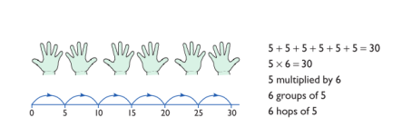
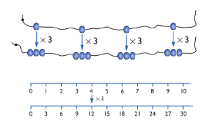
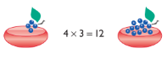
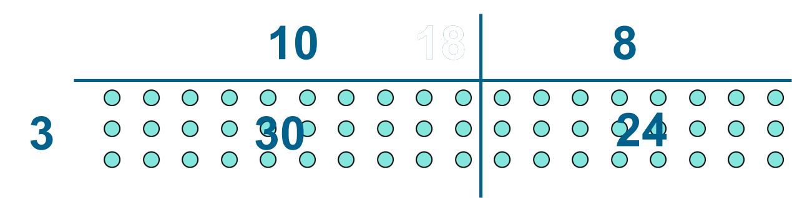
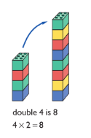
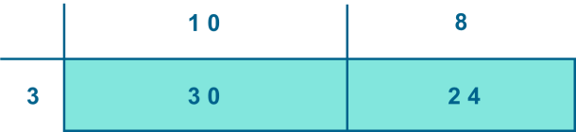
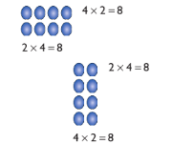
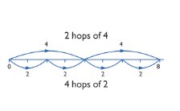
Year 1 | Year 2 | Year 3
Understand multiplication is related to doubling and combing groups of the same size (repeated addition) Washing line, and other practical resources for counting. Concrete objects. Numicon; bundles of straws, bead strings Problem solving with concrete objects (including money and measures Use cuissenaire and bar method to develop the vocabulary relating to ‘times’ – Pick up five, 4 times Use arrays to understand multiplication can be done in any order (commutative) | Expressing multiplication as a number sentence using x Using understanding of the inverse and practical resources to solve missing number problems. 7 x 2 = = 2 x 7 7 x = 14 14 = x 7 x 2 = 14 14 = 2 x x ⃝ = 14 14 = x ⃝ Develop understanding of multiplication using array and number lines (see Year 1). Include multiplications not in the 2, 5 or 10 times tables. Begin to develop understanding of multiplication as scaling (3 times bigger/taller) Doubling numbers up to 10 + 10 Link with understanding scaling Using known doubles to work out double 2d numbers (double 15 = double 10 + double 5) Towards written methods Use jottings to develop an understanding of doubling two digit numbers. 16 10 6 x2 x2 20 12 | Missing number problems Continue with a range of equations as in Year 2 but with appropriate numbers. Mental methods Doubling 2 digit numbers using partitioning Demonstrating multiplication on a number line – jumping in larger groups of amounts 13 x 4 = 10 groups 4 = 3 groups of 4 Written methods (progressing to 2d x 1d) Developing written methods using understanding of visual images Develop onto the grid method Give children opportunities for children to explore this and deepen understanding using Dienes apparatus and place value counters

Slide 14
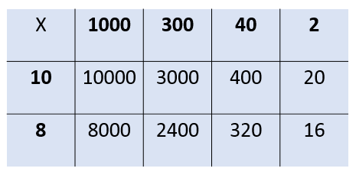
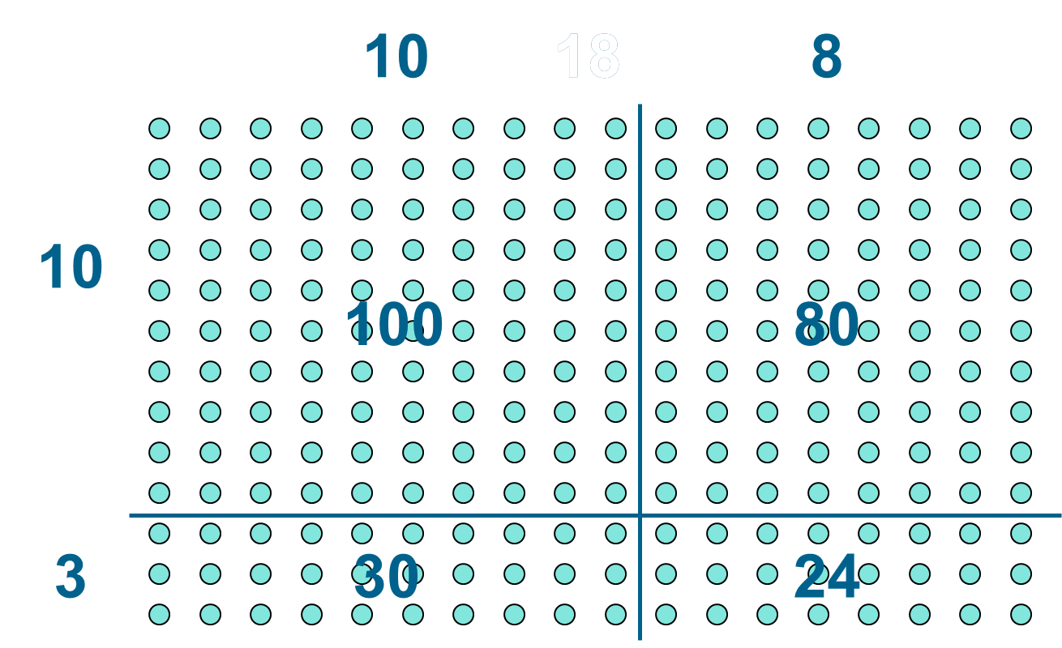
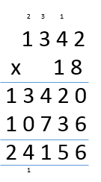
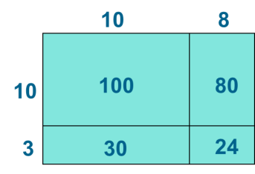
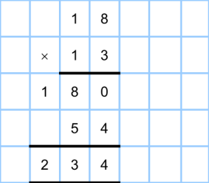
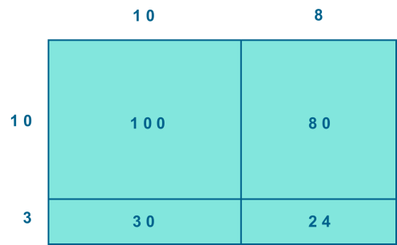
Year 4 | Year 5 | Year 6
Continue with a range of equations as in Year 2 but with appropriate numbers. Also include equations with missing digits 2 x 5 = 160 Mental methods Counting in multiples of 6, 7, 9, 25 and 1000, and steps of 1/100. Solving practical problems where children need to scale up. Relate to known number facts. (e.g. how tall would a 25cm sunflower be if it grew 6 times taller?) Written methods (progressing to 3d x 2d) Children to embed and deepen their understanding of the grid method to multiply up 2d x 2d. Ensure this is still linked back to their understanding of arrays and place value counters. | Continue with a range of equations as in Year 2 but with appropriate numbers. Also include equations with missing digits Mental methods X by 10, 100, 1000 using moving digits ITP Use practical resources and jottings to explore equivalent statements (e.g. 4 x 35 = 2 x 2 x 35) Recall of prime numbers up 19 and identify prime numbers up to 100 (with reasoning) Solving practical problems where children need to scale up. Relate to known number facts. Identify factor pairs for numbers Written methods (progressing to 4d x 2d) Long multiplication using place value counters Children to explore how the grid method supports an understanding of long multiplication (for 2d x 2d) | Continue with a range of equations as in Year 2 but with appropriate numbers. Also include equations with missing digits Mental methods Identifying common factors and multiples of given numbers Solving practical problems where children need to scale up. Relate to known number facts. Written methods Continue to refine and deepen understanding of written methods including fluency for using long multiplication

Slide 15
Division

Slide 17

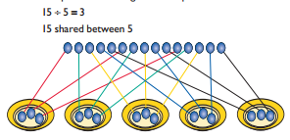
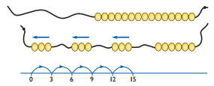

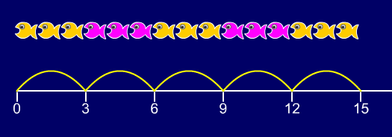


Year 1 | Year 2 | Year 3
Children must have secure counting skills- being able to confidently count in 2s, 5s and 10s. Children should be given opportunities to reason about what they notice in number patterns. Group AND share small quantities- understanding the difference between the two concepts. Sharing Develops importance of one-to-one correspondence. Children should be taught to share using concrete apparatus. Grouping Children should apply their counting skills to develop some understanding of grouping. Use of arrays as a pictorial representation for division. 15 ÷ 3 = 5 There are 5 groups of 3. 15 ÷ 5 = 3 There are 3 groups of 5. Children should be able to find ½ and ¼ and simple fractions of objects, numbers and quantities. | ÷ = signs and missing numbers 6 ÷ 2 = = 6 ÷ 2 6 ÷ = 3 3 = 6 ÷ ÷ 2 = 3 3 = ÷ 2 ÷ ∇ = 3 3 = ÷ ∇ Know and understand sharing and grouping- introducing children to the ÷ sign. Children should continue to use grouping and sharing for division using practical apparatus, arrays and pictorial representations. Grouping using a numberline Group from zero in jumps of the divisor to find our ‘how many groups of 3 are there in 15?’. 15 ÷ 3 = 5 Continue work on arrays. Support children to understand how multiplication and division are inverse. Look at an array – what do you see? | ÷ = signs and missing numbers Continue using a range of equations as in year 2 but with appropriate numbers. Grouping How many 6’s are in 30? 30 ÷ 6 can be modelled as: Becoming more efficient using a numberline Children need to be able to partition the dividend in different ways. 48 ÷ 4 = 12 +40 + 8 10 groups 2 groups Remainders 49 ÷ 4 = 12 r1 +40 + 8 + 1 10 groups 2 groups Sharing – 49 shared between 4. How many left over? Grouping – How many 4s make 49. How many are left over? Place value counters can be used to support children apply their knowledge of grouping. For example: 60 ÷ 10 = How many groups of 10 in 60? 600 ÷ 100 = How many groups of 100 in 600?

Slide 18
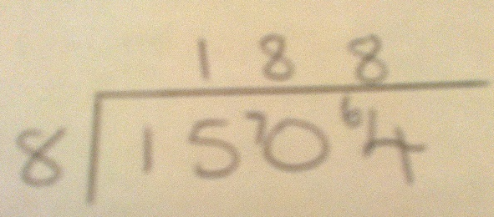
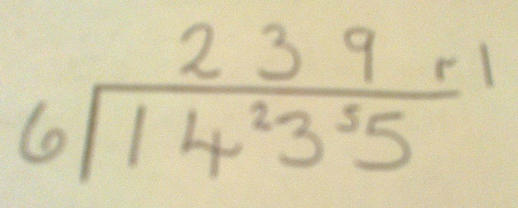
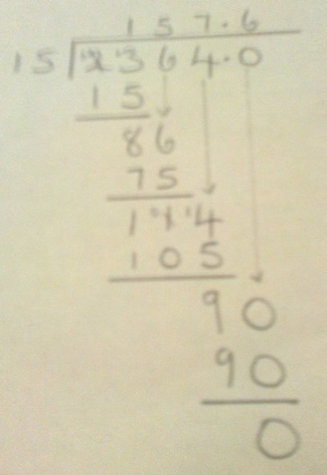
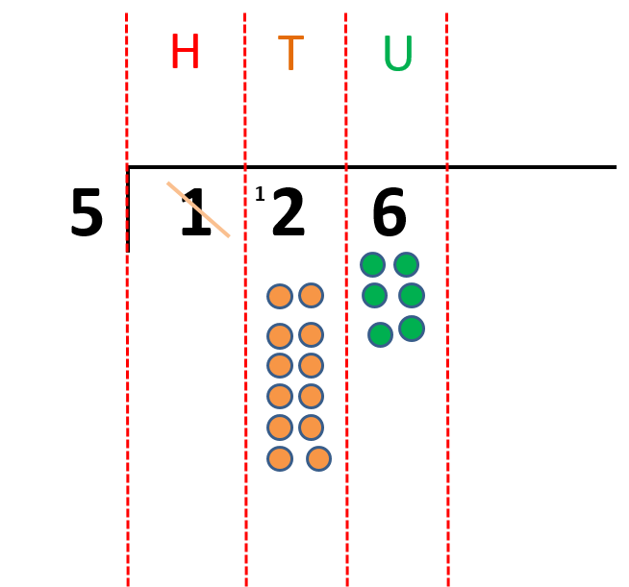
Year 4 | Year 5 | Year 6
÷ = signs and missing numbers Continue using a range of equations as in year 3 but with appropriate numbers. Sharing, Grouping and using a number line Children will continue to explore division as sharing and grouping, and to represent calculations on a number line until they have a secure understanding. Children should progress in their use of written division calculations: Using tables facts with which they are fluent Experiencing a logical progression in the numbers they use, for example: Dividend just over 10x the divisor, e.g. 84 ÷ 7 Dividend just over 10x the divisor when the divisor is a teen number, e.g. 173 ÷ 15 (learning sensible strategies for calculations such as 102 ÷ 17) Dividend over 100x the divisor, e.g. 840 ÷ 7 Dividend over 20x the divisor, e.g. 168 ÷ 7 All of the above stages should include calculations with remainders as well as without. Remainders should be interpreted according to the context. (i.e. rounded up or down to relate to the answer to the problem) |  | ÷ = signs and missing numbers Continue using a range of equations but with appropriate numbers Sharing and Grouping and using a number line Children will continue to explore division as sharing and grouping, and to represent calculations on a number line as appropriate. Quotients should be expressed as decimals and fractions Formal Written Methods – long and short division E.g. 1504 ÷ 8 E.g. 2364 ÷ 15
Formal Written Methods Formal short division should only be introduced once children have a good understanding of division, its links with multiplication and the idea of ‘chunking up’ to find a target number (see use of number lines above) Short division to be modelled for understanding using place value counters as shown below. Calculations with 2 and 3-digit dividends. E.g. fig 1 | Formal Written Methods Continued as shown in Year 4, leading to the efficient use of a formal method. The language of grouping to be used (see link from fig. 1 in Year 4) E.g. 1435 ÷ 6 Children begin to practically develop their understanding of how express the remainder as a decimal or a fraction. Ensure practical understanding allows children to work through this (e.g. what could I do with this remaining 1? How could I share this between 6 as well?)
Jottings
7 x 100 = 700
7 x 10 = 70
7 x 20 = 140
e.g. 840 ÷ 7 = 120
100 groups
20 groups
0
700
840

