Slide 1
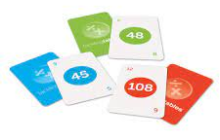
Year 3/4 Curriculum: A Guide for Parents
This guide is designed to provide information for parents and carers about the end of year expectations and an overview of the National Curriculum alongside the school-based curriculum.
Curriculum overview:
At BJA we run a 4 year rolling programme of topics (shown below) Some children may start in year 3 in year C, but will cover all topics during their time at BJA.
Year A | Year B | Year C | Year D
Under the sea | To infinity and beyond! | Branston at War | Walk like an Egyptian
Chocolate | Extinction! | British Settlers | Eco Warriors
Extreme Earth | Inventors | Rainforests | The Olympics
Maths: Times tables:
By the end of year 4 all children will be tested ,as part of the Government’s Multiplication Check. By the end of year 4 the expectation is that children know their times tables up to 12x12 and can answer questions within 5 seconds. This is a key area of learning you can support at home.
HANDY HINT! We use tackling times tables cards (which you can also purchase online). All children will also be given a Times Tables Rockstars login. We also recommend playing games, songs and quick fire practice at home. The website timestables.co.uk is also very useful

Slide 2
Maths: End of year expectations:
Year 3 | Year 4
Compare & order numbers up to 1000. Read & write all numbers to 1000 in digits and words. Find 10 or 100 more/less than a given number. Count from 0 in multiples of 4, 8, 50 and 100. Recall & use multiplication & division facts for 3, 4, 8 tables. Recognise place value of any 3-digit number. Add and subtract: 3-digit nos and ones 3-digit nos and tens 3-digit nos and hundreds Add and subtract: Numbers with up to 3-digits using written columnar method. Estimate and use inverse to check. Multiply: 2-digit by 1-digit Count up/down in tenths. Compare and order fractions with same denominator. Add and subtract fractions with same denominator with whole. Tell time using 12 and 24 hour clocks; and using Roman numerals. Tell time to nearest minute. Know number of days in each month and number of seconds in a minute. | Count backwards through zero to include negative numbers. Compare and order numbers beyond 1,000. Compare and order numbers with up to 2 decimal places. Read Roman numerals to 100. Find 1,000 more/less than a given number. Count in multiples of 6, 7, 9, 25 and 1000. Recall and use multiplication and division facts all tables to 12x12. Recognise PV of any 4-digit number. Round any number to the nearest 10, 100 or 1,000. Round decimals with 1dp to nearest whole number. Add and subtract numbers with up to 4-digits using written columnar method. Multiply: 2-digit by 1-digit 3-digit by 1-digit Count up/down in hundredths. Recognise and write equivalent fractions Add and subtract fractions with same denominator. Read, write and convert time between analogue and digital 12 and 24 hour clocks.

Slide 3
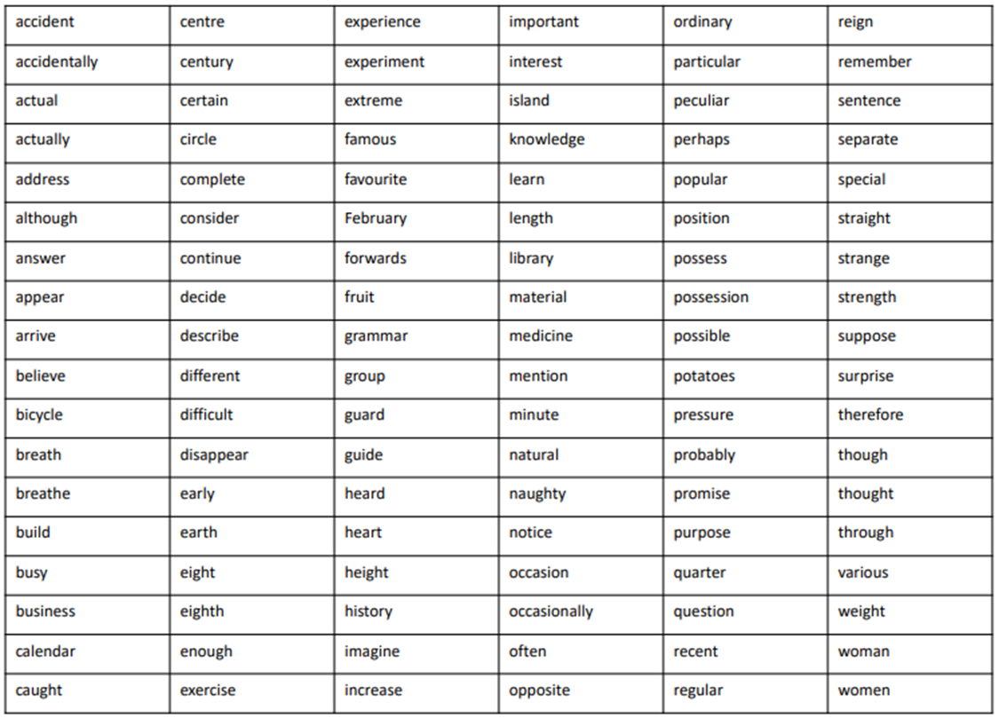
Writing: End of year expectations:
Year 3 | Year 4
Use conjunctions (when, so, before, after, while, because). Use adverbs (e.g. then, next, soon). Use prepositions (e.g. before, after, during, in, because of). Experiment with adjectives to create impact. Correctly use verbs in 1st, 2nd and 3rd person. Use perfect form of verbs to mark relationships of time and cause. Use inverted commas to punctuate direct speech. Group ideas into basic paragraphs. Write under headings and sub-headings. Write with increasing legibility, consistency and fluency. | Vary sentence structure, using different openers. Use adjectival phrases (e.g. biting cold wind). Use appropriate choice of noun or pronoun. Use fronted adverbials. Use apostrophe for plural possession. Use a comma after fronted adverbial (e.g. Later that day, I heard bad news.). Use commas to mark clauses. Use inverted commas and other punctuation to punctuate direct speech. Use paragraphs to organised ideas around a theme. Use connecting adverbs to link paragraphs. Write with increasing legibility, consistency and fluency.
Spelling list for Year 3/4: (Children may also review the Year 1/2 list)

Slide 4
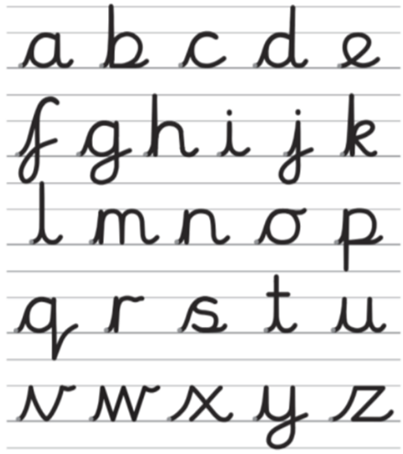
Handwriting: These are the letter formations we encourage:
Reading: End of year expectations:
Year 3 | Year 4
Comment on the way characters relate to one another. Know which words are essential in a sentence to retain meaning. Draw inferences such as inferring characters’ feelings, thoughts and motives from their actions. Recognise how commas are used to give more meaning. Recognise inverted commas Recognise: plurals pronouns and how used collective nouns adverbs Explain the difference that the precise choice of adjectives and verbs make. | Give a personal point of view on a text. Re-explain a text with confidence. Justify inferences with evidence, predicting what might happen from details stated or implied. Use appropriate voices for characters within a story. Recognise apostrophe of possession (plural) Identify how sentence type can be changed by altering word order, tenses, adding/deleting words or amending punctuation. Explain why a writer has used different sentence types or a particular word order and the effect it has created. Skim & scan to locate information and/or answer a question.

Slide 5
Science: End of year expectations:
 | Year 3 | Year 4
Planning an investigation | From a range of question starts, can generate simple questions that could lead to scientific enquiry. Can suggest a possible series of steps in an investigation. Can suggest which equipment they need to use, and measurements/observations that need to be made. | With support, can plan a suitable series of steps in an investigation. Selects appropriate equipment and, with support, considers the degree of accuracy required when measuring. Asks questions and can generate simple questions that could lead to scientific enquiry.
Fair Testing | With support, as part of a fair test, can identify those elements that need to be kept the same. | In a fair test, identifies what to change and what to keep the same.
Prediction | Can make a prediction of a possible outcome and can offer a relevant reason. | Can make a prediction of a possible outcome, and can offer a reason based on experience/general knowledge.
Safety | Follows written safety instructions, linked to equipment. | Can suggest simple safety measures. Uses equipment suitably.
Collecting evidence | Makes relevant observations, creating clear diagrams. Uses standard measuring equipment for quantities such as length or weight. Creates own tables and bar charts. | Makes a series of observations. Uses standard measuring equipment for quantities, including temperature and volume. Creates own tables, including a line chart with support.
Results and conclusions | With support, can describe simple patterns in the results, and begin to explain them. With prompting, recognises limitations of enquiry, and how it might be improved. | Makes a general statement about results, supported by patterns. Relates results back to prediction. Suggests how the enquiry might be adjusted or improved. Recognises some of the limitations of the enquiry.

